Slide 1

Research Assistant for Emerging Scientific Domains
Submitted By:
Nithyashree CP
Computer Science & Engineering (AI&ML)
Department of CSE(AI&ML), MCE, Hassan

Slide 2
Agenda
Problem Understanding
Objectives
Why Agentic Architecture
System Architecture
Agent Responsibilities
Data Acquisition & Cleaning
Iterative Agentic Loop
Memory & Uncertainty Handling
Results & Visualization
Implementation & Deployment
Challenges faced
Conclusion and Future Scope
References

Slide 3

Problem Understanding
Modern scientific research spans multiple rapidly evolving domains, making manual literature review, hypothesis formulation, and experimentation time-consuming and error-prone.
There is a need for an autonomous research system capable of discovering emerging domains, synthesizing knowledge from heterogeneous sources, and iteratively refining research outputs without human intervention.

Slide 4

Objectives
Discovers emerging scientific domains (post-2024)
Generates novel research questions
Collects and cleans real-world data
Designs and critiques experiments
Iteratively refines outputs
Produces a structured mini research paper with confidence scores

Slide 5

Why Agentic Architecture
Single-agent or RAG-based systems lack:
Self-critique
Iterative refinement
Memory-driven reasoning
Conflict resolution
This system uses a multi-agent architecture where agents collaborate, critique each other, and operate under a supervisor to demonstrate true agency.

Slide 6
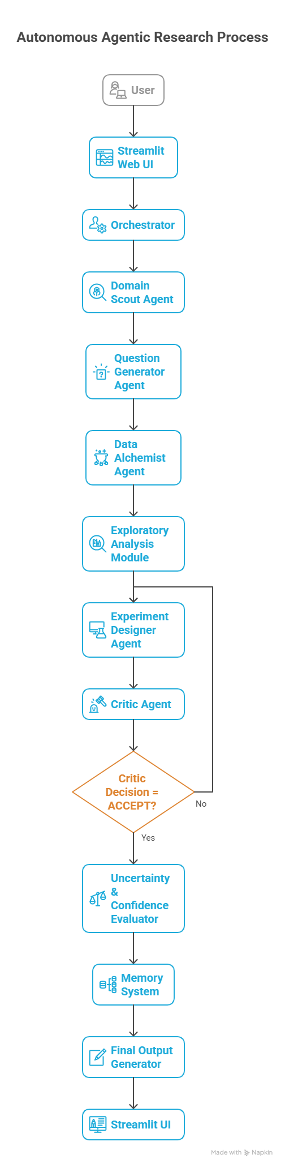
System Architecture
The system is orchestrated using LangGraph, enabling controlled execution flow across agents.
Key components:
Streamlit UI for interaction
LangGraph orchestration layer
Specialized autonomous agents
Pinecone vector memory
External data sources (arXiv + Web)

Slide 7
Agent Responsibilities
Supervisor Agent: Controls iteration count and termination
Domain Scout Agent: Discovers emerging domains using arXiv (post-2024) and web signals
Question Generator Agent: Generates novel research questions
Data Alchemist Agent: Collects and cleans heterogeneous data sources
EDA Agent: Identifies patterns and risks
Experiment Designer Agent: Designs and executes lightweight, data-driven experiments
Critic Agent: Enforces refinement cycles through rejection
Uncertainty Agent: Assigns confidence scores
Paper Writer Agent: Produces final research paper

Slide 8

Data Acquisition & Cleaning
Data Sources
arXiv research papers (PDF abstracts)
CSV-like metadata derived from arXiv (title length, abstract length, publication year)
Web search signals (DuckDuckGo)
Processing Includes:
Text extraction
Metadata summarization
Structured representation for downstream agents

Slide 9
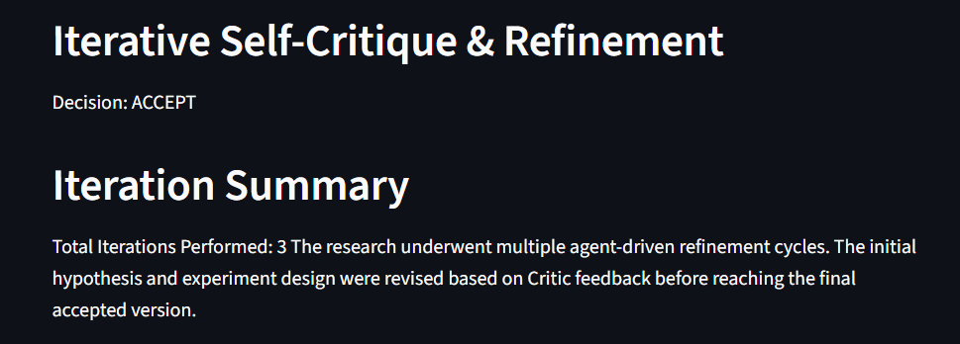
Iterative Agentic Loop
Initial experiment is intentionally rejected
Critic Agent enforces refinement
Supervisor Agent loops execution (up to 5 iterations)
Each iteration improves hypothesis and experimental rigor
Loop terminates on ACCEPT decision or iteration limit

Slide 10
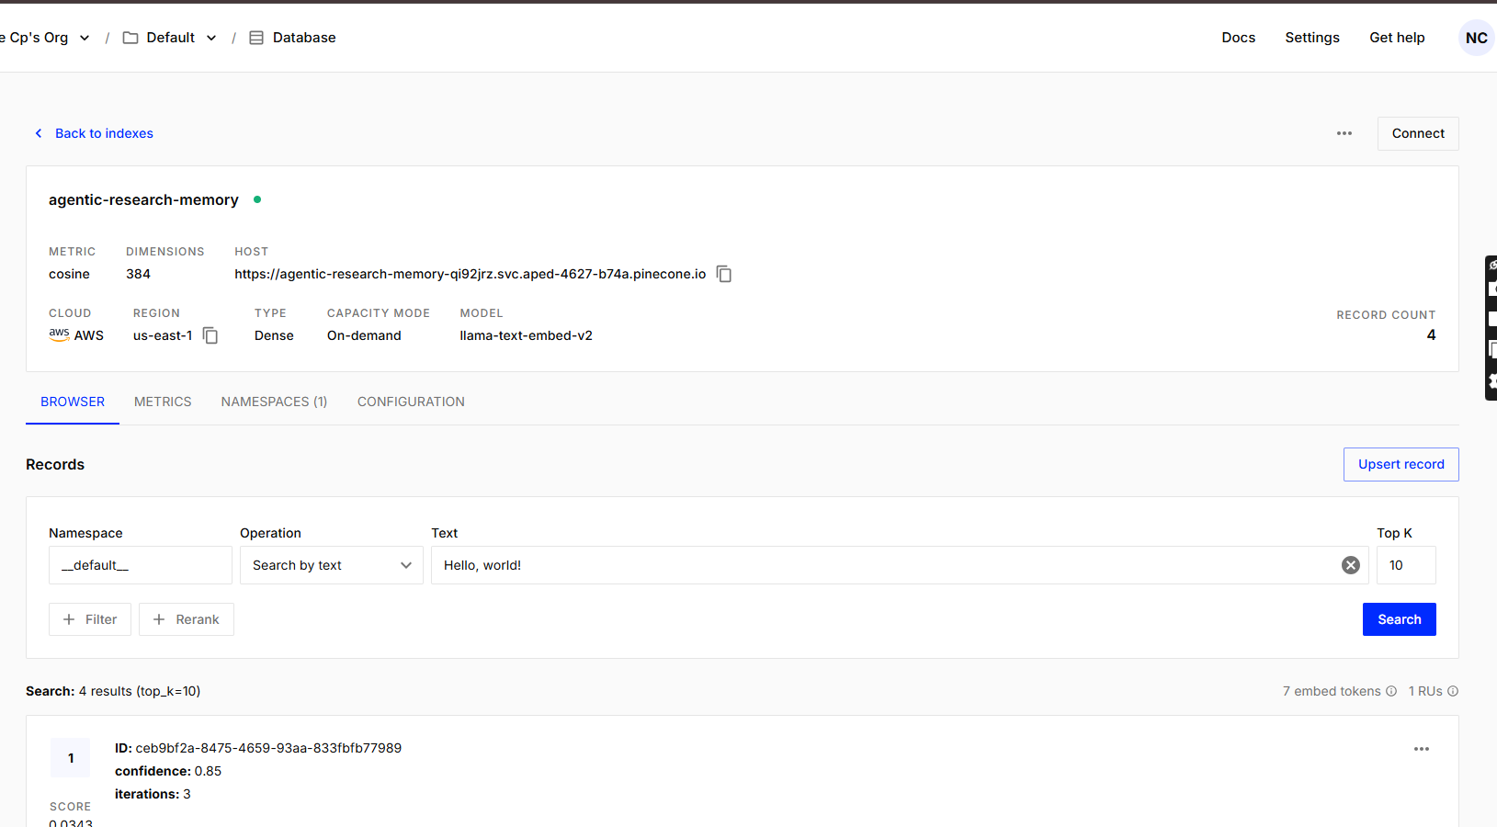
Memory & Uncertainty Handling
Pinecone Vector Database stores:
Research papers
Confidence scores
Iteration metadata
Sentence Transformers used for embeddings
Uncertainty Agent assigns heuristic confidence scores (≥0.6)
Confidence and iteration history are visualized
Department of CSE(AI&ML), MCE, Hassan

Slide 11
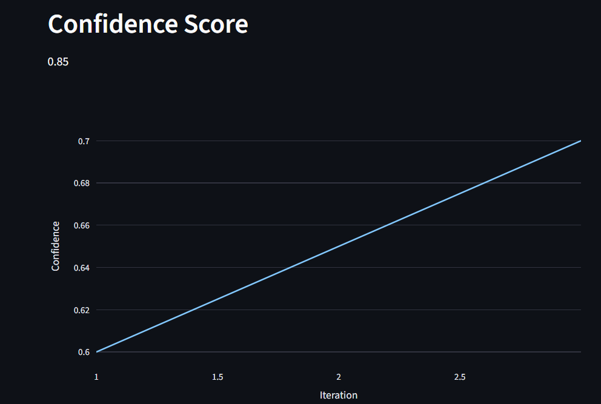
Results & Visualization
Final outputs include:
Auto-generated Mini Research Paper (Markdown)
Iteration summary
Confidence score
Interactive Plotly chart showing confidence vs iterations
All outputs are generated without human input after startup.
Department of CSE(AI&ML), MCE, Hassan

Slide 12
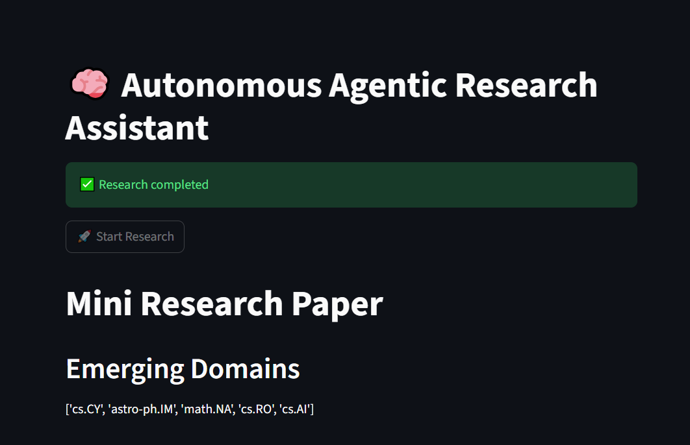
Implementation & Deployment
Implemented in Python with modular agent structure
Agent orchestration handled using LangGraph
Deployed using Git-based CI on Streamlit Cloud
Environment variables used for secure API management
The system provides a live, interactive research interface.
https://agentic-autonomous-research-imprcudar7d34ny22ygujh.streamlit.app
Department of CSE(AI&ML), MCE, Hassan

Slide 13
Challenges Faced
Handling noisy and unstructured data from arXiv and web sources
Applying scientific critique without formal statistical tests
Preventing infinite agent loops during self-refinement
Working within free-tier API and compute limits
Estimating confidence without labeled ground truth
Department of CSE(AI&ML), MCE, Hassan

Slide 14
Conclusion & Future Scope
Conclusion: This project demonstrates a fully autonomous multi-agent research system that performs domain discovery, data analysis, iterative self-critique, and research paper generation without human intervention
Future Scope: Future work includes full-text PDF processing, stronger statistical validation, and richer long-term memory for deeper autonomous scientific exploration
Department of CSE(AI&ML), MCE, Hassan

